Slide 1
statistics
For first stage prepared by Aseel Ali

Slide 2
Regression
Regression analysis is a set of statistical methods used for the estimation of relationships between a dependent variable and one or more independent variables. It can be utilized to assess the strength of the relationship between variables and for modeling the future relationship between them. Regression analysis includes several variations, such as linear, multiple linear, and nonlinear

Slide 3
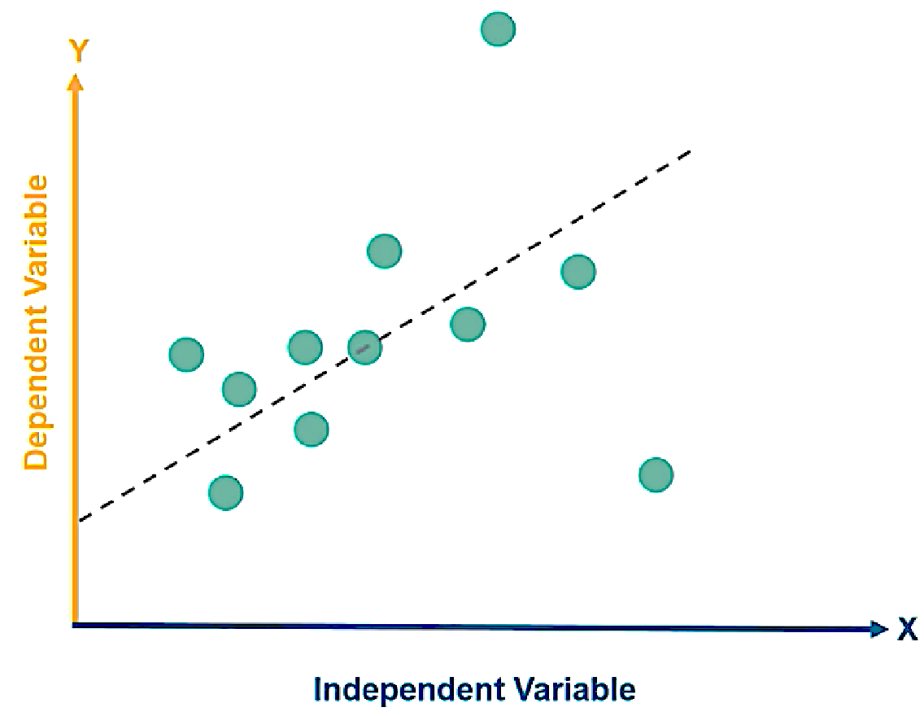
Example of Independent & Dependent Variables:
x is Rainfall and y is Crop Yield

Slide 4
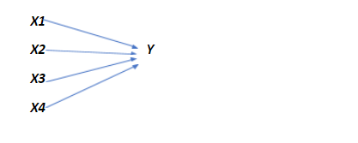
If the relationship with the dependent variable is in the form of single variables, then it is known as Simple Linear Regression
Simple Linear Regression
X —–> Y
If the relationship between Independent and dependent variables are multiple in number, then it is called Multiple Linear Regression
Multiple Linear Regression

Slide 5
Simple Linear Regression Model
As the model is used to predict the dependent variable, the relationship between the variables can be written in the below format.
$$y_{i}=β_{0}+β_{1}x_{i}+ε_{i}$$
Where,
$y_{i} −$ Dependent variable
$β_{0}−$ Intercept
$β_{1}−$Slope Coefficient
$x_{i}−$ Independent Variable
$ε_{i}−$ Random Error Term (Residual)

Slide 6
Estimating linear regression function
That the most used method for estimating parameters is the OLS Ordinary least square method. This method is based on the principle of ((minimizing the sum of squares of errors)) as it seeks to find the parameters that make the sum of squares of error as minimal as possible.
$\hat{y}$ $={\hat{β}}_{0}+{\hat{β}}_{1}x$
${\hat{β}}_{1}=\frac{\sum{x_{i}y_{i}}−n{\overline{x}}_{i}{\overline{y}}_{i}}{\sum{{x^{2}}_{i}^{}}−n{{\overline{x}}^{2}}_{i}}$ or $\frac{n\sum_{i=1}^{n}{x_{i}y_{i}−(\sum_{i=1}^{n}{x_{i})(\sum_{i=}^{n}{y_{i}}}})}{n\sum_{i=1}^{n}{{x_{i}}^{2}−(\sum_{i=1}^{n}{{x_{i}^{})}^{2}}}}$
${\hat{β}}_{0}= \overline{y}$ $−{\hat{β}}_{1}\overline{x}$

Slide 7
${\hat{β}}_{1}=\frac{\sum{xy−\frac{\sum{x}\sum{y}}{n}}}{\sum{x^{2}−\frac{{(\sum{x})}^{2}}{n}}}$ $=\frac{\sum{(x_{i}−\overline{x})(y_{i}−\overline{y})}}{\sum{{(x_{i}−\overline{x})}^{2}}}$
$\overline{x }$ and $\overline{y}$ are the mean values of $x$ and $y$respectively .
and the estimate of the error variance is
$σ^{2}=\frac{SSE}{n−2}$

Slide 8
Where Residual sum of squares :
$$SSE=\sum_{i=1}^{n}{{y_{i}}_{}^{2}−{\hat{β}}_{0}}\sum_{i=1}^{n}{y_{i}}−{\hat{β}}_{1}\sum_{i=1}^{n}{x_{i}}y_{i}$$

Slide 9
Example :Find linear regression equation for the following two sets of data:
x | 2 | 4 | 6 | 8
y | 3 | 7 | 5 | 10

Slide 10
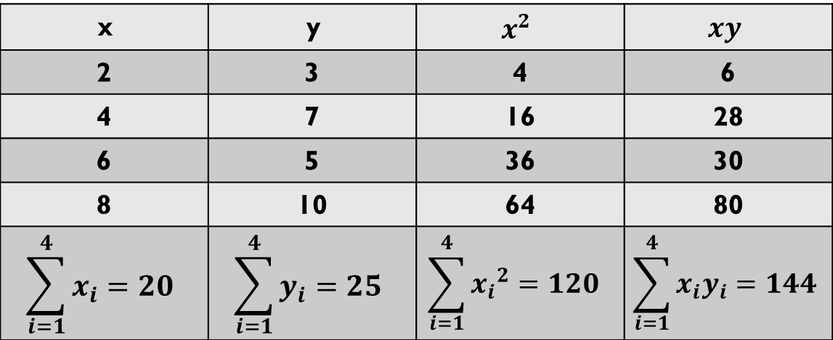
$$xy$$ | $$x^{2}$$ | y | x
6 | 4 | 3 | 2
28 | 16 | 7 | 4
30 | 36 | 5 | 6
80 | 64 | 10 | 8
$$\sum_{i=1}^{4}{x_{i}y_{i}}=144$$ | $$\sum_{i=1}^{4}{{x_{i}}^{2}}=120$$ | $$\sum_{i=1}^{4}{y_{i}}=25$$ | $$\sum_{i=1}^{4}{x_{i}}=20$$

Slide 11
For this example
$\sum_{i=1}^{4}{x_{i}=2+4+6+8=20}$
$$\sum_{i=1}^{4}{y_{i}}=3+7+5+10=25$$
$$\sum_{i=1}^{4}{{x_{i}}^{2}}= {(2)}^{2}+{(4)}^{2}+{(6)}^{2}+ {\left(8\right)}^{2}=120$$
$$\sum_{i=1}^{4}{{y_{i}}^{2}}= {(3)}^{2}+{(7)}^{2}+{(5)}^{2}+ {\left(10\right)}^{2}=183$$
$$\sum_{i=1}^{4}{x_{i}y_{i}}=\left(2×3\right)+\left(4×7\right)+\left(6×5\right)+\left(8×10\right)=144$$

Slide 12
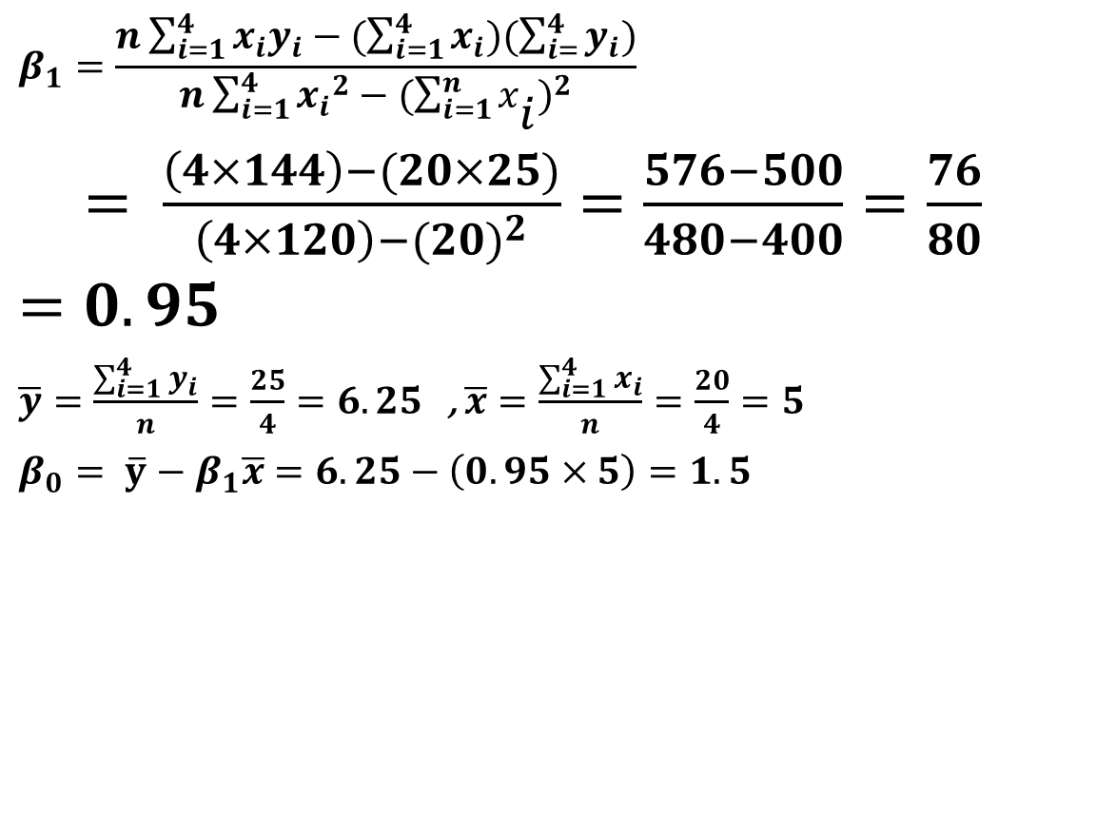
$$β_{1}=\frac{n\sum_{i=1}^{4}{x_{i}y_{i}−(\sum_{i=1}^{4}{x_{i})(\sum_{i=}^{4}{y_{i}}}})}{n\sum_{i=1}^{4}{{x_{i}}^{2}−(\sum_{i=1}^{n}{{x_{i}^{})}^{2}}}}$$
$= \frac{\left(4×144\right)−(20×25)}{\left(4×120\right)−{(20)}^{2}}=\frac{576−500}{480−400}=\frac{76}{80}=0.95$
$\overline{y}=\frac{\sum_{i=1}^{4}{y_{i}}}{n}=\frac{25}{4}=6.25$, $\overline{x}=\frac{\sum_{i=1}^{4}{x_{i}}}{n}=\frac{20}{4}=5$
$β_{0}= \overline{y}$ $− β_{1}\overline{x}$ $=6.25−\left(0.95×5\right)=1.5$

Slide 13
The fitted regression line :
$\hat{y}$ $={\hat{β}}_{0}+{\hat{β}}_{1}x=1.5+0.95x$
$σ^{2}= \frac{\sum_{i=1}^{n}{{y_{i}}_{}^{2}−{\hat{β}}_{0}}\sum_{i=1}^{n}{y_{i}}−{\hat{β}}_{1}\sum_{i=1}^{n}{x_{i}}y_{i}}{n−2}$
$= \frac{183−\left(1.5×25\right)−(0.95×144)}{2}=\frac{183−37.5−136.8}{2}=\frac{8.7}{2}=4.35$
$$σ= \sqrt{4.35 }$$

Slide 14
Exercise: For the following data
Find:
1-Estimated regression equation of y on x .
2-The estimated value of y when x equals 2.5

